Slide 1
Descriptive-Statistics Calculator
SOEN 6611: SOFTWARE MEASUREMENT
[TEAM H]
VEDANSHI PATEL
MRIDUL PATHAK
HEMANSHU CHOURASIA
MEHUL PRAJAPATI
BHARTI SAINI
HARSH KUMAR RAVAL

Slide 2
Agenda:
GQM
Effort Estimation using The Use Case Points
Effort Estimation using Basic Cocomo
Cyclomatic Number
Object Oriented Metrics(WMC, CF and LCOM*)
Physical and Logical SLOC
Logical SLOC vs WMC
Conclusion

Slide 3
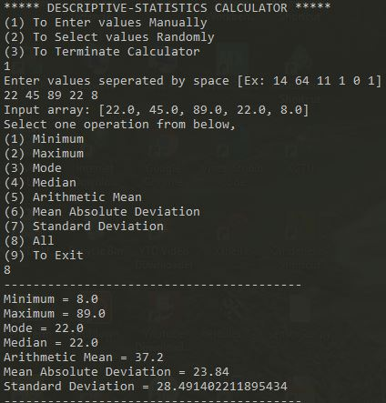
Calculator Functionality
Minimum
Maximum
Median
Mode
Arithmetic Mean
Mean Absolute Deviation
Standard deviation

Slide 4
GQM
Goal :Analyze the statistic-calculator with respect to its quality for Deliverable 1 (June 16, 2020) for the purpose of characterization from the developer ’s point of view which includes quality of documentation, quality of the coding,implementation of the functionalities, accuracy of the calculated data and performance of system.
Some of the metrics used :
Logical SLOC
Flow Charts
UCP
Algorithmic cost model
Complexity Number

Slide 5
The Use Case Points (UCP)
Estimation technique used for estimating effort based on use case
Using UCP was:
Easy to learn and apply
Didn’t require any extensive infrastructure or a software tool to produce the estimate.
Effort Estimate = UCP×PF
Effort Estimate = [UUCP × TCF × ECF]×PF
Effort Estimate = [(UAW + UUCW)× TCF × ECF]×PF
Effort Estimate = [(2 + 40)× 0.735× 0.485]×20
Effort Estimate = 299.439 = 300 person-hours.
Highlights: 1 average actor; 4 Simple and 2 Average Use Case; Technical Factor = 13.5 (performance, End User Efficiency, Reusability, Easy to Use, Easy to Change); Environmental Factor = 30.5 (Familiarity with Use Case Domain, Object-Oriented Experience, Stable Requirements)

Slide 6
Constructive Cost Model (COCOMO)
The cost models provide direct estimates of effort (or duration).
We had to estimate the size of the project (LOC) based on the sample project and required features.
Using COCOMO:
Gave us the idea how long will it take to develop the project and how much effort will be required.
Was easy to implement, we only had to make approximate estimate of the project ie KDSI(Kilo Delivered Source Instruction) which was the only tricky part
Effort Estimate = a(S)^b*F
Approx S =0.61 of KLOC
Effort Estimate =251.37 person-hours
Comparison: There is difference of 48.63 person-hours when comparing these values with UCP model.
Notes:
Cocomo estimate value : 252 hours * 6 people = 1512 man hours
UCP total hours : 300*6 = 1800 total project estimated hours using UCP approach
Actual Values : Considering : 6weeks * 5 working days * 8 hours *6 people = 1440 man hours
Conclusion :
1. Values of Perceived Impact Factor which are subjective and are assigned
as per developers knowledge.
2. The assumption regarding person-hours for calculation of Productivity
Factor.
3. For UCP we have taken in account a lot of use cases. That has caused
inflation in the value of the effort estimation using UCP approach. Consider-
ing the factor that some use cases are not highly complex, the actual value
would be less.

Slide 7
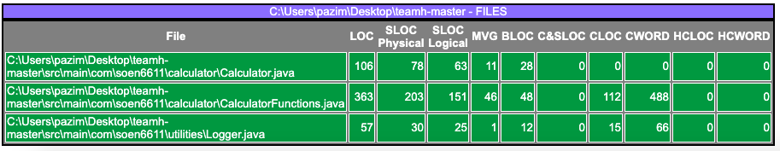
Cyclomatic Number
The cyclometric complexity is a tool metrology software to measure the complexity of a computer program.
A simple code, with a low cyclomatic number is theoretically easier to read ,to test and to maintain.
The tool we used to calculate McCabe VG complexity is LocMetrics.
Our calculated cyclomatic value falls under the category of High Risk Assessment.
Notes:
The cyclomatic number , the cyclomatic complexity is a tool metrology software developed by Thomas McCabe in 1976 to measure the complexity of a computer program .
The cyclomatic number reflects the number of decisions of an algorithm by counting the number of linearly independent “paths” through a program represented in the form of a graph .
The tool that we used to calculate the McCabe VG Complexity is LocMetrics and the output is represented here
and we confirmed it manually through a source code flowchart
Formula we used to calculate the cyclomatic number is:
M = E-N + 2P
M = cyclomatic complexity;
E = the number of edges of the graph;
N = the number of nodes in the graph;
P = the number of connected components of the graph.
4. The McCabe VG Complexity score we attained was 58
5. Our calculated cyclomatic value falls under category of High risk assessment. This was one of the major reasons we did not implement the GUI so that we don’t increase our complexity substantially.

Slide 8

Object Oriented Metrics
Weighted method per Class (WMC)
For our project WMC=58, we found out that class “CalculatorFunctions” has higher frequency as it contained the most of the methods.
Conclusion:For our project we found out that class “CalculatorFunctions” had significantly higher frequency as it contained the most of the methods and hence would require more time and effort to maintain and it limits it’s reuse.

Slide 9
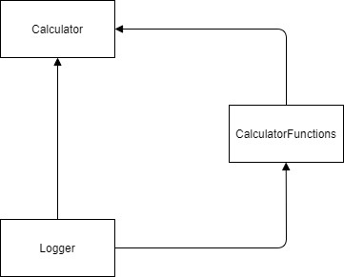
COUPLING FACTOR (CF) :
Conclusion: High CF reflects deliberate high coupling to other classes. This, in turn, can be a negative to maintainability. For our project CF value is 0.5 so its moderate which shows that project is moderate to maintain.

Slide 10

Lack of Cohesion in Methods (LCOM)
For our project LCOM= 0.98
High LCOM or LCOM closer to 1 is an indication of low cohesion. This, in turn, can be a negative to maintainability (analyzability, modifiability, and testability .
For our project LCOM value is 0.98 which indicate low cohesion and indicate that our project needs to be divided into multiple classes to increase cohesion

Slide 11

Dividing a class to multiple classes can decrease the complexity but increase the execution time as well as code length. Multiple classes will have multiple calls and multiple objects which somehow affect the software quality.

Slide 12
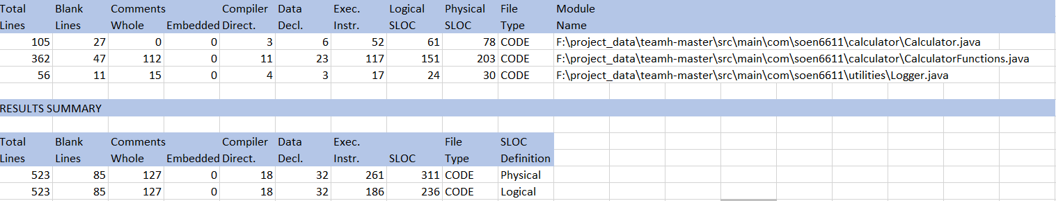
Physical and Logical SLOC
Used for measuring the size of systems software
Serves as a basis for a number of other metrics like cost estimation, productivity, defect density etc.
Tool Used: Unified Code Count
The standard UCC rules for java are followed by the tool for counting the SLOC.
Result obtained from UCC tool
Notes:
SLOC as we know is Source lines of code. It is used for measuring the size of software.
However, more SLOC does not mean that the software is better. It depends on the quality of code(like readability, understandability etc)
One Physical line starts with a character and ends with a carriage return or an end of line marker and excludes comments and blank lines.
A logical SLOC can provide an accurate count of cases such as multiple logical statements residing on a single line, or that single logical statement spanning multiple lines.
The tool we have used is UCC(Unified code count)
This image is a screenshot from UCC tool result.

Slide 13
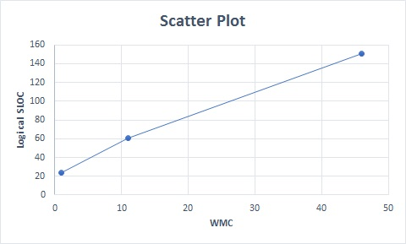
Logical SLOC vs WMC
Linear non-decreasing relation between logical SLOC and WMC
Pearson correlation coefficient r = 0.5376
Strong positive correlation between logical SLOC and WMC
Notes:
For 3 classes
WMC = 1, 11, 46
Logical SLOC = 21, 64, 151

Slide 14
Thank you
Questions?

